Slide 1


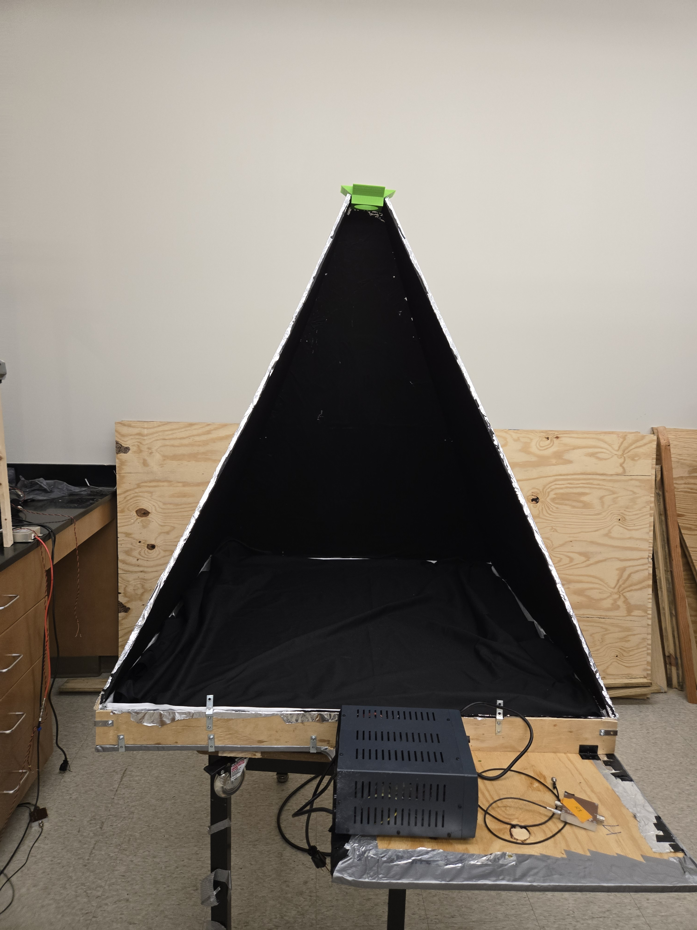
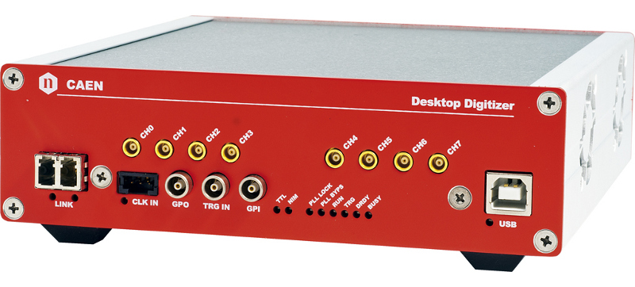
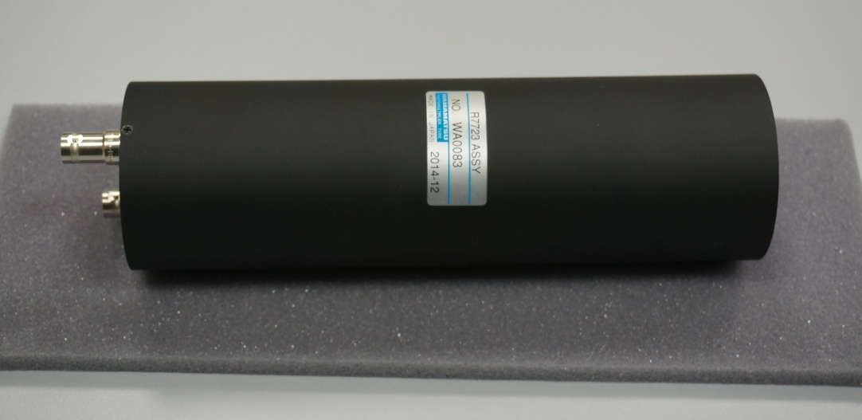
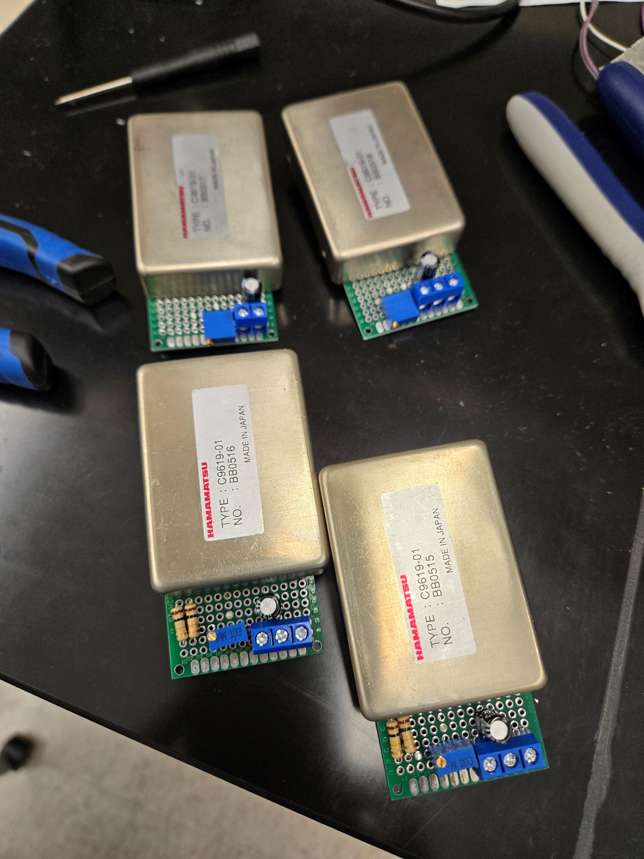
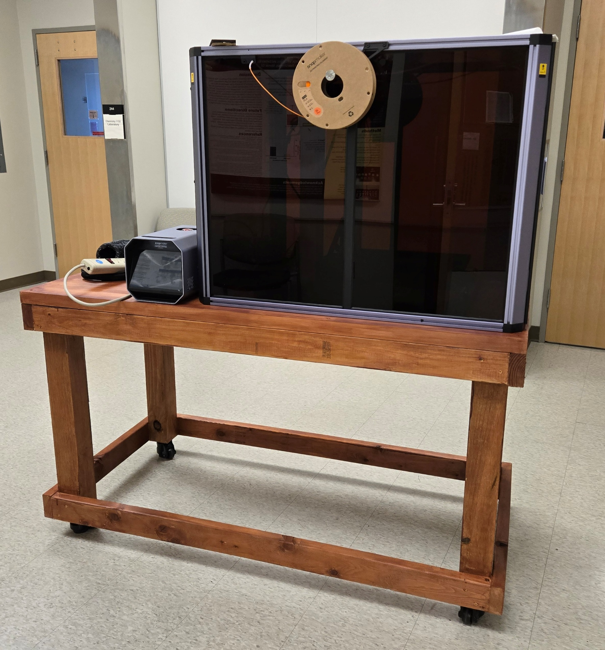
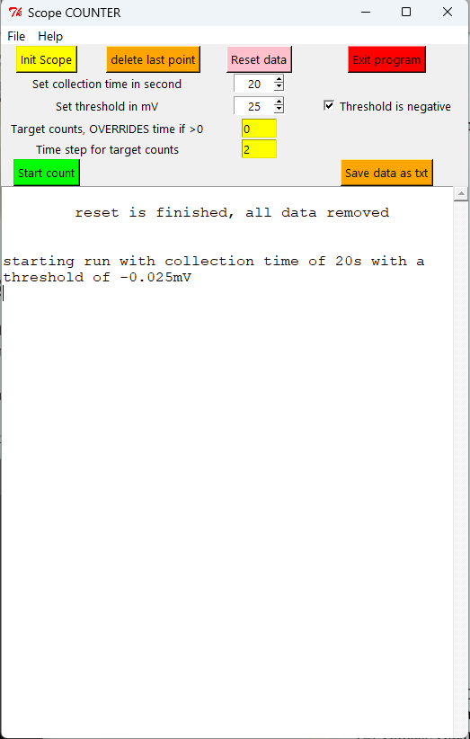
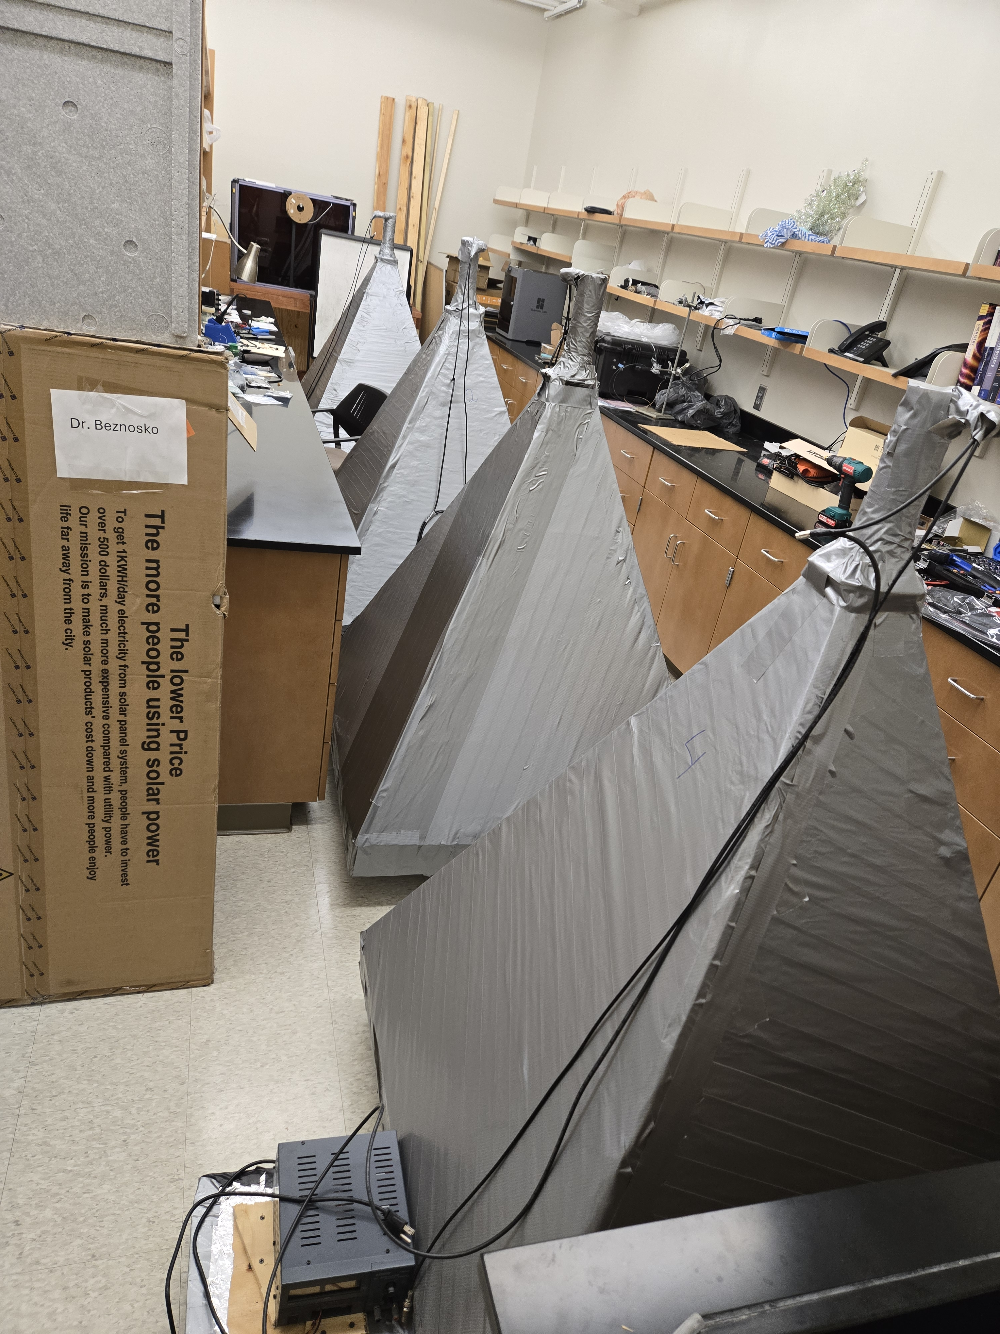
Construction completion of the DUCK (Detector of Unusual casKades) detector system
By: Dmitriy Beznosko* for DUCK Collaboration
14th Cosmic-Ray International Studies and Multi-messenger Astroparticle Conference.
July 2026, Sorrento, Italy
*Presenter. dmitriybeznosko@clayton.edu
ABSTRACT
The poster presents the construction completion and deployment of core modules of DUCK (Detector system of Unusual Cosmic-ray casKades) [1], a cosmic-rays detector system aimed to study the Extensive Air Shower (EAS) disk thickness as compared to CORSIKA simulations, to join the efforts in the search for the Cosmic Ray Ensembles and to further study the latest advances in the cosmic-rays field [2], like studying the multi-modal cosmic ray events. The project involves multiple areas like computer simulation activities, design and construction, data acquisition system design, data collection and analysis, allowing participation of students pursuing not only physics but also other STEM fields, such as Chemistry, Engineering and Computer Science.
Introduction
The design of the DUCK project calls for the basic 4 modules. The design for a single module is shown in Figure 1, and all four completed modules are in Figure 2. Each module has a 5-cm thick, 1m x 1m plastic scintillator, a 2-inch PMT (photo multiplier tube) for the light detection, each module would be calibrated to assess the particle density. Figure 3 shows the last (4th ) module right before completion.
Fast response of each module makes possible to record waveform of the signal to look for the unusual events CAEN DT5730 FADC is used (Figure 4), with 14-bit resolution and 500 MHz digitization speed for the fast signal resolution and custom DAQ software [3, 4]. Hamamatsu H11284-30 (former R7723) PMT is chosen for the large area of the photocathode (2”) and fast output pulse (Figure 5). Hamamatsu MPPC + WLS fiber for MIP calibration of each module.
Project Progress
Module 1-4 are successfully completed and are under calibration.
All power supplies for the modules are complete, outfitted with controls (Figure 6) and installed.
Modules need to undergo rigorous testing and calibration process after completion.
Calibration automation software development has been completed [4, 5].
The new 3D printer and laser cutter has been installed on a house-built low-vibrational table (Figure 7)
Figure 4: CAEN DT5730 FADC
Figure 3: Inside a module
Figure 5: Hamamatsu PMT H11284-30 (former R7723)
Figure 6: Power supplies for modules 3 and 4 (PMT and MPPC)
Figure 7: 3D printer and laser cutter on a new table
Calibration Automation Software
The calibration of the detector module starts with finding the biasing voltage for the two photosensors used – PMT and MPPC. The initial stage of this process involves measuring the noise rate vs the biasing voltage at each device.
The process involves counting the noise rate at multiple threshold values for each bias voltage amount. The counting is done by the oscilloscope, and the threshold settings need to be updated at each measurement. Bias voltage is updated at the power supply. Therefore, software that updates the threshold and saves the values in a convenient format (.csv) is an asset.
Figure 8 shows the screenshot of the software main window. The functionality allows to initialize the oscilloscope, to set the threshold, to read the count value after a preselected time period, manipulate and plot the data, and save it as a .cvs file format. A possibility to save a .ROOT file directly from the plot also exists if needed.
The calibration software uses the pyvisa interface to issue commands to the oscilloscope (VISA stands for Virtual Instrument Software Architecture).
ROOT is used for the plotting the data as its being collected and for the possibility of saving into the .root file format [4, 5]. The preference is given to the .cvs format for the data as the datafiles are small and the .cvs format is more flexible and easier to work with.
Figure 9 shows plot of log of noise rate vs. voltage threshold measured from MPPC photosensor. The characteristic steps indicate the pixel nature of this device (total of about 1200 pixels) – first step is all pixel combinations firing, second step at higher threshold is 2 pixels and higher multiplicity, third step is three pixels and above, etc.
Figure 8. The main window of the calibration software
Figure 9. The MPPC log10 of noise rate vs the threshold for 67.6V bias
Conclusion
The status of the DUCK project:
All 4 modules are complete
Calibration are in progress
All electronic components have been installed and tested
Calibration automation software is complete
Future Plans
The following immediate tasks are needed for the completion of the DUCK project:
Complete all calibration activities
Prepare signal cables for physics run deployment (cables are available)
Implement and test LED calibration automation during the run
Start initial runs using 2 modules at the time (i.e. separation curve test) and add others
Prepare for the modules placement and physics run
LV power supply
ADC
HV power supply
PMT
References
[1] D. Beznosko, V. Aseykin, A. Dyshkant, A. Iakovlev, O. Krivosheev, T. Krivosheev, V. Shiltsev, X.M. Tran and V. Zhukov. “Construction and calibration of the DUCK (Detector of Unusual casKades) system modules”. In proceedings of The European Physical Society Conference on High Energy Physics, PoS(EPS-HEP2025)521, 2026/01/06, https://doi.org/10.22323/1.485.0521
[2] Tomasz Hachaj et al., “Towards detection of anomalous cosmic ray signals for observations acquired from Cosmic Ray Extremely Distributed Observatory mobile detectors”, Engineering Applications of Artificial Intelligence 161 112109, 2025/12/9 https://doi.org/10.1016/j.engappai.2025.112109
[3] D. Beznosko et al., “Progress of construction and calibration of main modules for the DUCK (Detector of Unusual casKades) system”, in proceedings of
39th International Cosmic Ray Conference, PoS(ICRC2025)191, 2025/10/04 https://doi.org/10.22323/1.501.0191
[4] Dmitriy Beznosko et al. "Construction progress of Detector of Unusual Cosmic-ray casKades", Proceedings of 4th Annual College of STEM Symposium, PROC(04ACSS2025)002, 03/2025 https://sos.clayton.edu/proceedings/004/PROC(04ACSS2025)002.pdf
[5] Dmitriy Beznosko, Farid Gasratov, Fernando Guadarrama, Alexander Iakovlev, “Scripting data acquisition operations and choice of data format for the data files of the DUCK ultra-high energy cosmic rays detector”, arXiv:2501.08235, 2025/1/14, https://doi.org/10.48550/arXiv.2501.08235
Function generator
WLS Fiber
MPPC
Scintillator
LED
Figure 1: The schematic design of the basic module
Figure 2: All four Basic modules are completed

